Slide 1
Design of Secure Remote Diag on Container Separation Architecture
Candidate: Vu Hoang Phi (phi.vu)
LGEDV – October 2026
Notes:
(Nhớ bật mouse laser) + Bật CAM
Hello everyone, my name is Phi, from Software Engineering part.
Today, I will present about the topic: Design of Secure Remote Diag on Container Separation Architecture

Slide 2
Content
1
Context & Motivation
2
Problem
3
Quality Attribute
4
Design Alternative
5
Comparison & Decision
6
Implementation & Verification
Notes:
For the topic presentation, I will go through six sections as you can see in the slide.
First one is Context of my Function Expert topic.

Slide 3
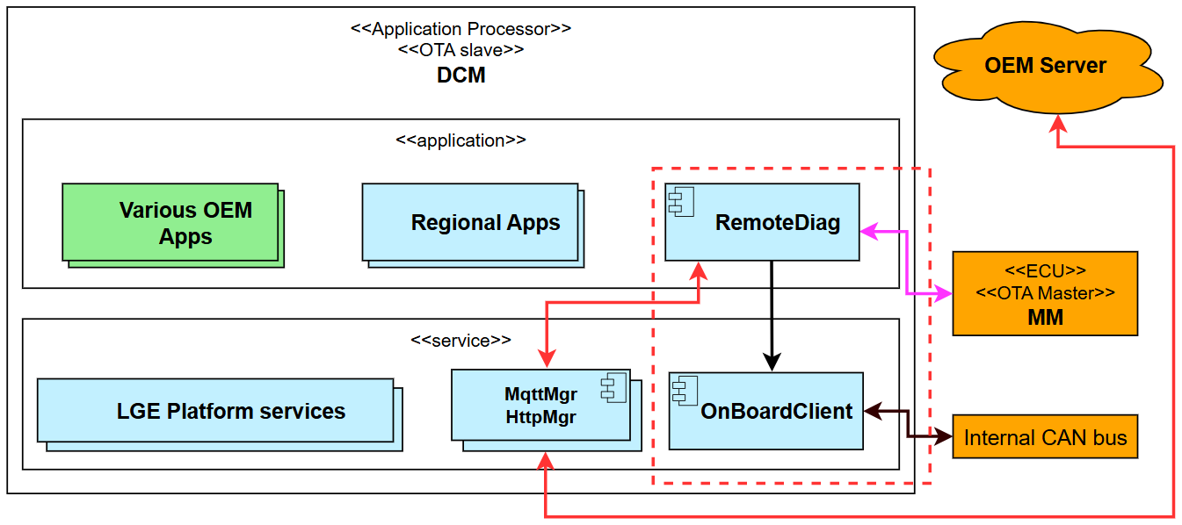
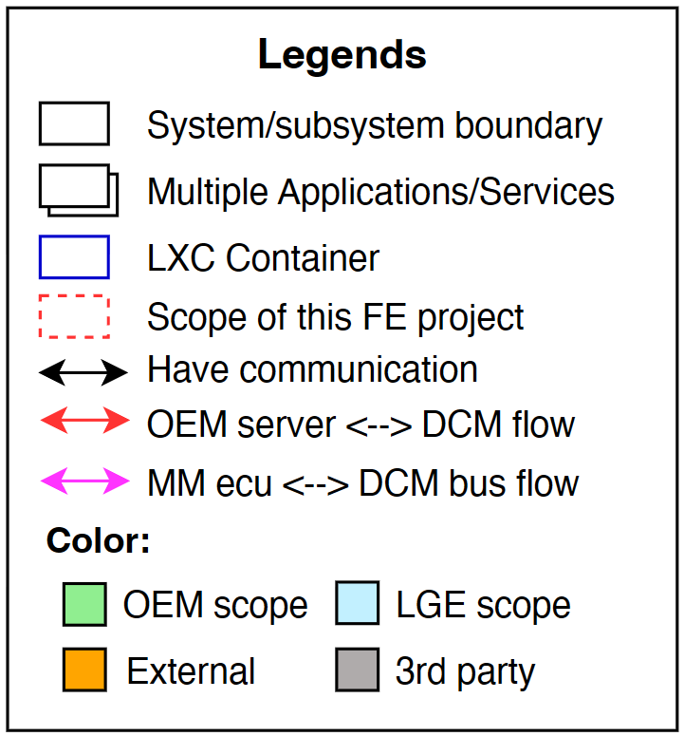
Context & Motivation – Toyota 24DCM project
Toyota DCM: a telematics platform providing connected vehicle services, including remote diagnostics from OEM server.
Supports diagnostic communication and OTA updates through the Internal CAN bus.
Current architecture: monolithic deployment model, with all components running in a single partition.
Current system architecture
Notes:
The Toyota DCM is a telematics platform which provides services that allows vehicles to connect to the network, including the remote diagnostics from OEM server.
and It also supports diagnostic communication and OTA update feature, through Internal CAN bus … and the MM ECU which acts as OTA Master.
As you can see in the diagram, the Current architecture is monolithic, with all components running in a single partition.
On next slide, we will talk about the architecture migration.

Slide 4
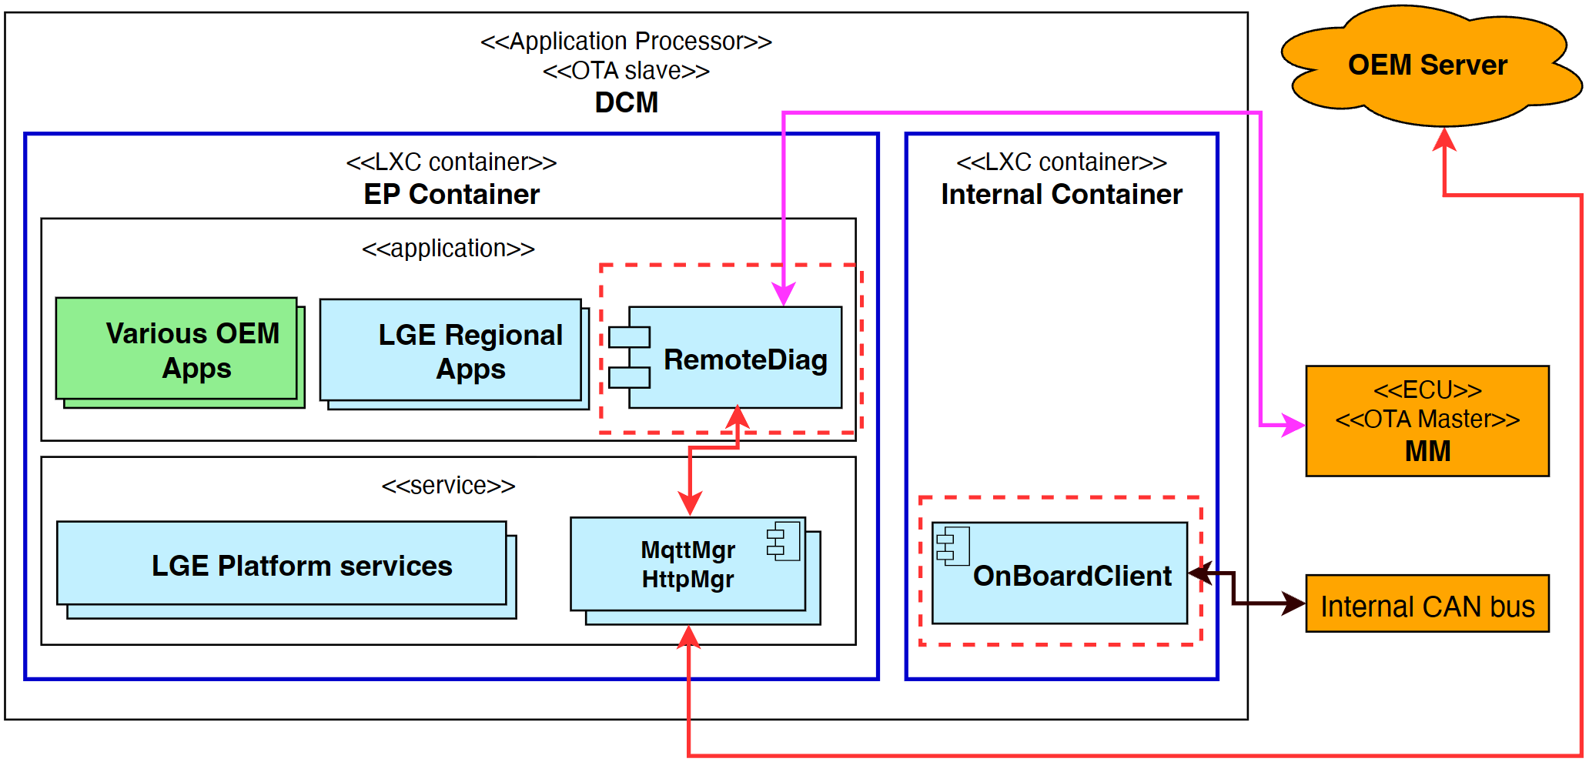
Context & Motivation – System architecture migration
OEM Security Threat: Entry Point (EP) partition (containing components which is able to communicate with network) could be compromised by unauthorized software and has been taken over.
OEM Security Proposal: The scope of compromise shall be limited to the EP partition and shall not propagate internal (to internal partition or in-vehicle CAN bus)
System architecture migration:
  DCM is separated into 2 partitions using LXC containers:
    EP container (Entry Point): externally exposed network components.
    Internal container: components which have access to CAN bus.
Current system architecture
New system architecture (containerized)
Notes:
From the OEM security perspective, a potential threat is that the Entry Point partition could be compromised by unauthorized software and taken over.
To address the security risk, OEM proposed the security requirements to limit the scope of compromise to the EP partition only. The compromise must not propagate to the internal partition or in-vehicle CAN bus.
Then, to achieve this, LGE came up with a solution: Separate the DCM architecture into two partitions using Linux container technology:
The EP container will hosts externally exposed network components
And The Internal container will hosts the components which require access to the CAN bus.

Slide 5
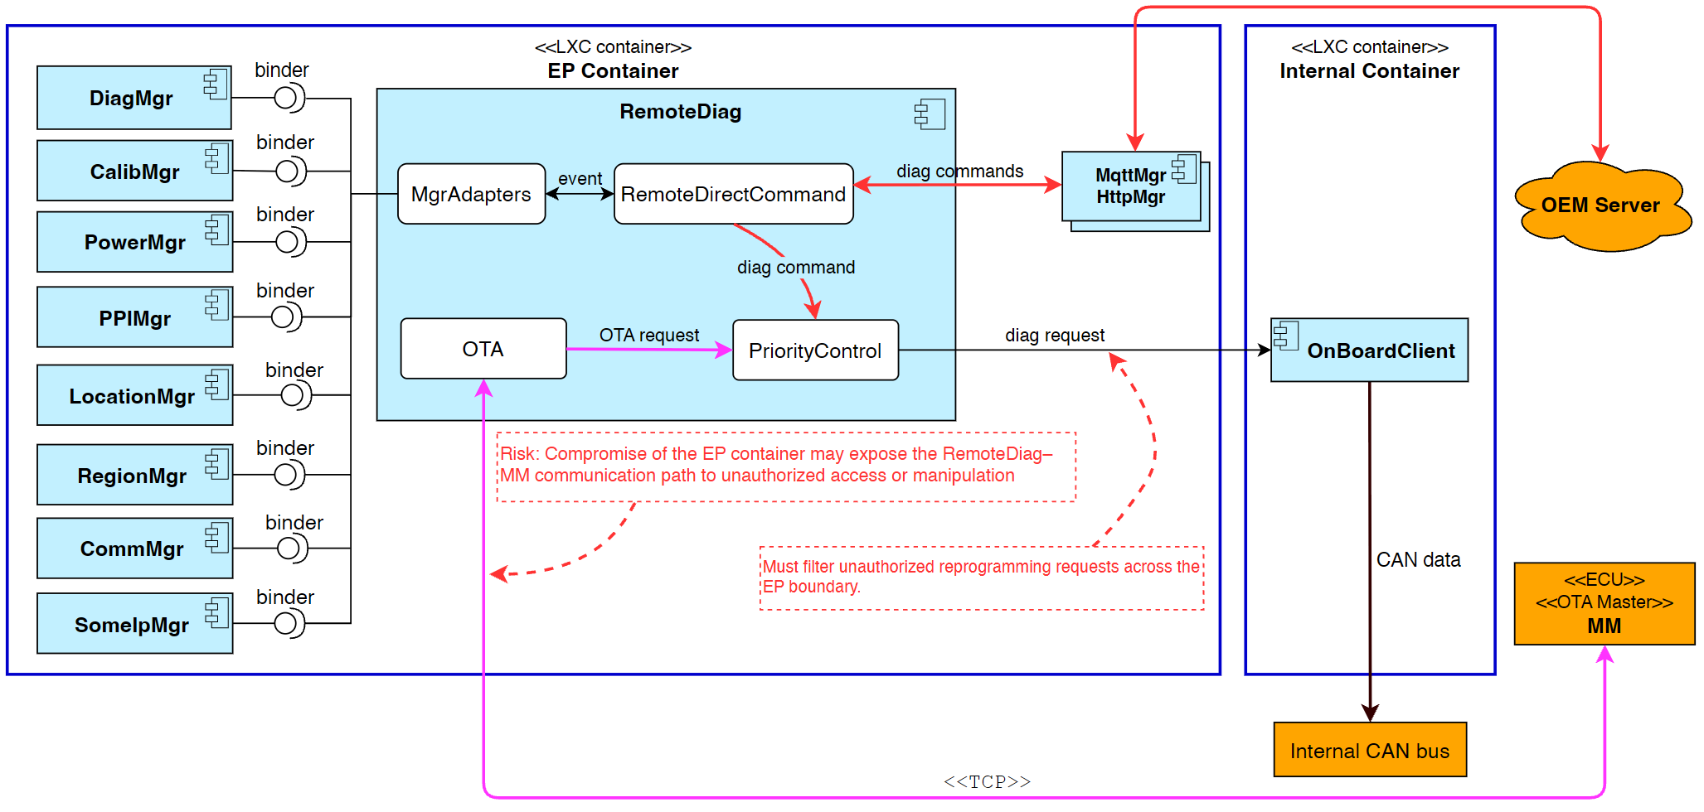
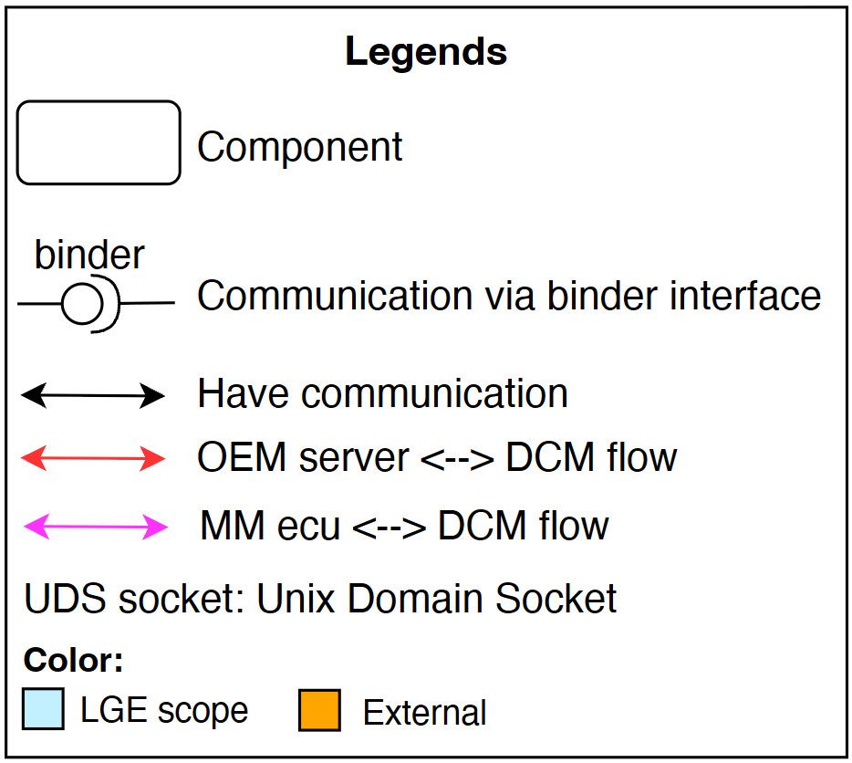
Problem
RemoteDiag: a module processes diagnostic for each ECU and uploads diagnostic data to OEM Server
RemoteDiag has 2 communication paths:
  with OEM Server: performs direct diagnostic commands
  with MM ecu: OTA diagnostic update
Risk: RemoteDiag <-> MM path traverses the EP container, exposing the communication to an attacker if EP container is compromised
OEM requests that unauthorized reprogramming requests should be filtered.
RemoteDiag’s internal architecture and communication should be redesigned to align with new architecture
Notes:
RemoteDiag is responsible for processing diagnotics for each ECU and uploading diagnostic data to the OEM server
Currently, RemoteDiag has two main communication paths:
One with the OEM server (the red flow), for direct diagnostic commands.
And The other one with the MM ECU (the pink flow), for OTA updates.
Then, the diagnostic commands will be sent to OnBoardClient then go to Internal CAN bus.
However, there are security risks in the current design:
The communication path between RemoteDiag and the MM ECU routes in the EP container. If the EP container is compromised, this communication could be exposed to an attacker.
And, OEM also requests that unauthorized reprogramming requests should be filtered
As a result, the internal architecture of RemoteDiag and communication flow need to be redesigned so that they are aligned with the new container architecture.”

Slide 6
Problem
Functional requirements
# | Description
FR-01 | The system shall block unauthorized diagnostic commands related to ECU reprogramming.
FR-02 | The system shall route UDS diagnostic messages exchanged with the MM ECU entirely within the Internal container.
Notes:
Base on OEM requirements and security perspective, I extract the functional requirements as shown in the table.

Slide 7
Quality Attribute
ID | Type | Priority | QA Scenario | Measure
QA-01 | Security | High | A compromised app/service sends reprogramming diagnostic to CAN | Zero Reprogramming SIDs reaches the internal CAN.
QA-02 | Security | High | MM ECU sends a diagnostic request via TCP to RemoteDiag | Zero diagnostic communication is found in EP. 100% number of requests are communicated within IP.
QA-03 | Modifiability | Medium | A new design reallocates responsibilities among existing software components. | No component is required to take responsibilities outside its originally defined role. No additional specification updates caused by responsibility expansion.
QA-04 | Maintainability | Medium | A new design requires existing software components (other than RemoteDiag) to adapt to the new architecture. | Number of component which needs to modify to align with new design
Notes:
Here is the quality attribute table which I’m concerning.
The table describes about QA scenarios and their measurement
Basically, I focus on Security attributes. Then, Modifiability and Maintainability.

Slide 8
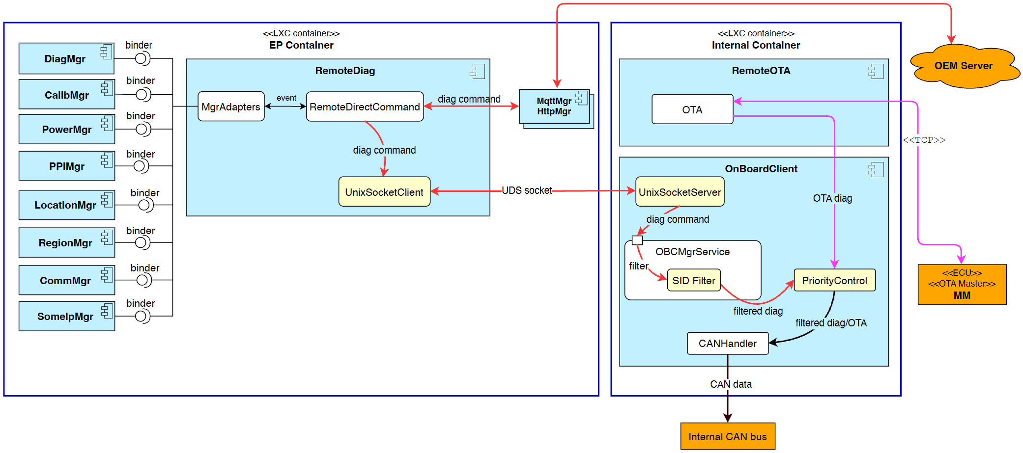
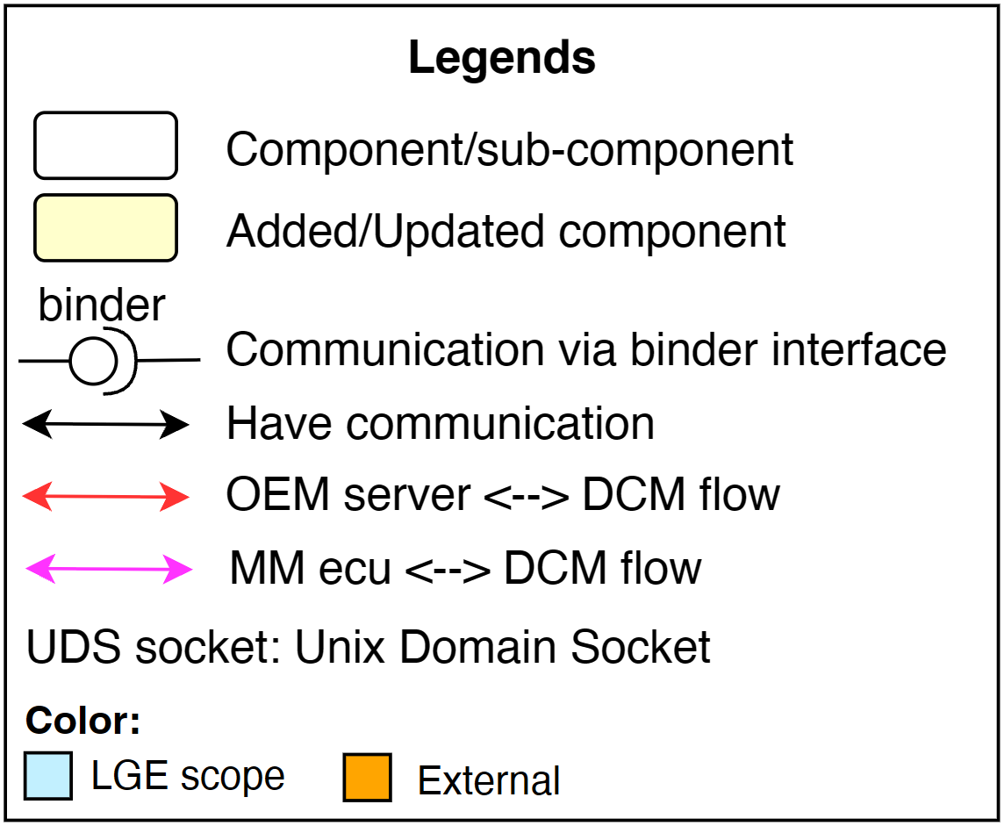
Design Alternative – Alt-A: Split RemoteDiag
Split RemoteDiag responsibilities into 2 apps:
  RemoteDiag (EP container): handles diag messages from OEM server.
  RemoteOTA (Internal container): handles OTA diag message flows from MM ECU.
OnBoardClient is responsible for reprogramming message filtering and diagnostic priority control.
Alt-A
Notes:
To satisfy OEM security requirements, I will come up with 3 design alternatives.
As shown in the slide, this is the first alternatives: Alternative A: Split RemoteDiag.
This design will separate RemoteDiag responsibilities into 2 applications:
- RemoteDiag locates in EP container to handle diagnostic commands from OEM server.
- RemoteOTA locates in Internal container to handle OTA commands from MM ECU.
- As a result, OnBoardClient is responsible for filtering the reprogramming messages and diagnostic priority control
The RemoteOTA stay in the same Internal container with OnBoardClient, then they can keep the communication path like RemoteDiag before via binder.
But for RemoteDiag, it will have to create an Unix Domain Socket communication for cross container.

Slide 9
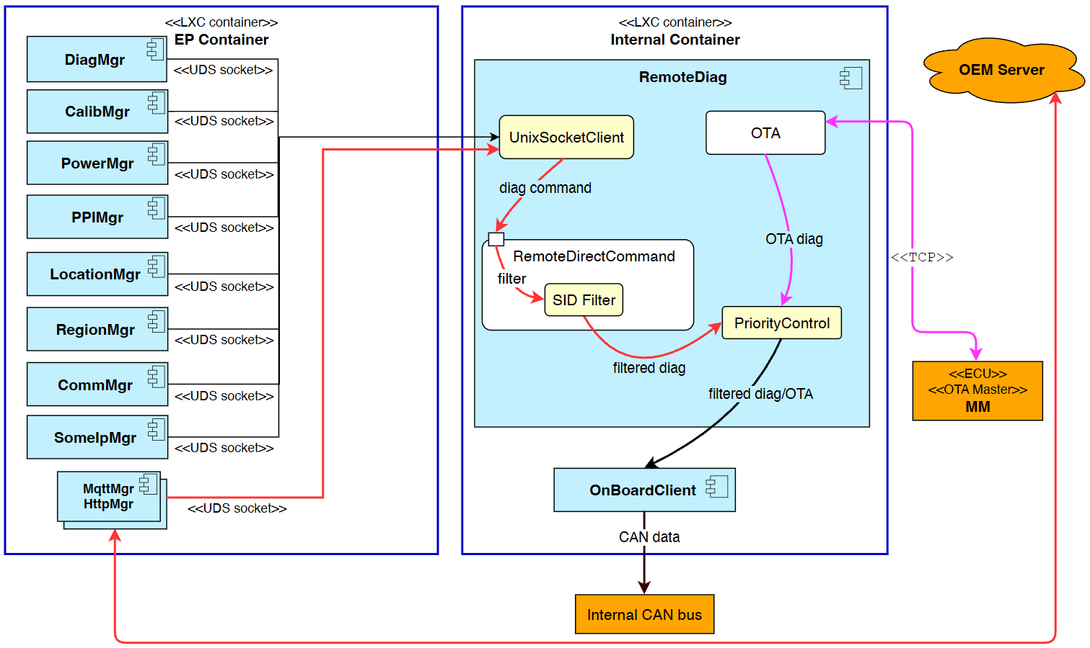
Design Alternative – Alt-B: Move RemoteDiag
Move RemoteDiag into the Internal container.
To maintain communication with OEM server and other EP-side component, establish UDS socket connections to each module
Alt-B
Notes:
The next is Alternative B: Move RemoteDiag
With this design, I move the RemoteDiag into Internal container.
To communicate with Other modules in EP sides, I have to create UDS socket connection between RemoteDiag and those modules.
This requires other modules in EP sides to change to implement UDS socket server.

Slide 10
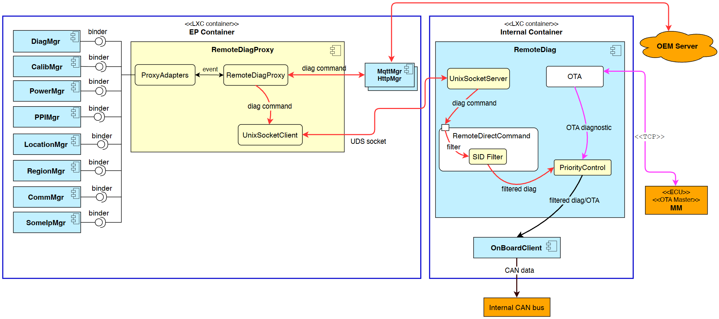
Design Alternative – Alt-C: Move RemoteDiag + Proxy
Move RemoteDiag into the Internal container.
Add a new RemoteDiagProxy (RDP) component in the EP that acts as a transparent proxy.
EP modules continue to interact with RDP using their existing interface
RemoteDiagProxy forwards requests to RemoteDiag via UDS socket channel.
Alt-C
Notes:
The last alternatives is Alternative C which is an update version of Alternative B:
I still move RemoteDiag into Internal container
And I add a new component in EP: RemoteDiagProxy, acting as a transparent proxy.
RemoteDiagProxy keeps the existing interface to communicate with other modules in EP side
And it forwards requests to RemoteDiag via UDS socket channel.

Slide 11

Comparison & Decision
 | Alt-A – Split RemoteDiag | Alt-B: Move RemoteDiag | Alt-C: Move RemoteDiag + Proxy
QA-01 Security | High Unauthorized diagnostic commands are filtered. | High Unauthorized diagnostic commands are filtered. | High Unauthorized diagnostic commands are filtered.
QA-02 Security | High MM ECU diagnostic traffic remains within the EP container. (CyberSecurity team confirmed) | High MM ECU diagnostic traffic remains within the EP container. (CyberSecurity team confirmed) | High MM ECU diagnostic traffic remains within the EP container. (CyberSecurity team confirmed)
QA-03 Modifiability | Low RemoteDiag and OnBoardClient’s responsibility is changed: - Diagnostic priority control is moved to OnBoardClient which requires requirement updates. - Existing RemoteDiag responsibilities are distributed across two applications, increasing OEM specification and coordination effort. | High Core responsibilities of existing components remain unchanged after migration. | High Core responsibilities of existing components remain unchanged after migration.
QA-04 Maintainability | Medium 01 additional component is modified (OnBoardClient - implements UDS socket server and priority control) | Low 10 EP modules (PowerMgr, HttpMgr, …) have to implement cross-container UDS socket communication and fail-safe handling. | Medium No changes required in existing modules but a new module RemoteDiagProxy is required. RemoteDiagProxy preserves the current binder interface.
Decision | Rejected | Rejected | Selected
High: Fully satisfy
Medium: Partially satisfy
Low: Not satisfy
Final decision: Alt-C
Notes:
This table describe about the comparison between design alternatives.
For filtering diagnostic commands
and keep communication path between RemoteDiag and MM ECU only routes in Internal container, all of the alternatives is satisfy.
But Alternative A is not satisfy the Modifiability – QA-three. Because it causes RemoteDiag and OnBoardClient responsibilities be changed:
- Diagnostic priority control is moved to OnBoardClient
- And Existing RemoteDiag responsibilities are distributed across two applications.
The other alternatives keeps the core responsibilities of RemoteDiag.
For the Maintainability – QA-four, Alternative B is not satisfied. About TEN modules in EP side have to implement Unix Domain Socket server to communicate with RemoteDiag then integrate with their existing code. And also, fail-safe mechanism.
Alternative A has to modify OnBoardClient to implement UDS socket server and priority control.
Alternative C has to implement RemoteDiagProxy.
Both Alternative A and C are partially satisfy for Maintainability.
So, with above comparison table, I chose Alternative C as it has highest score.

Slide 12
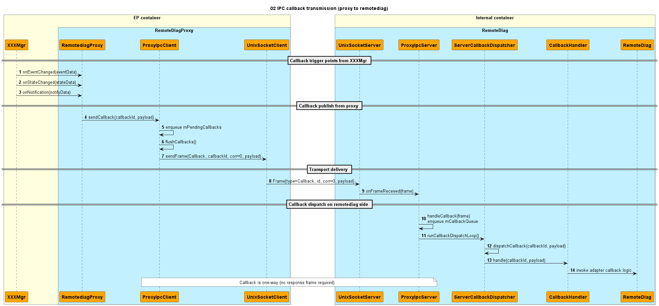
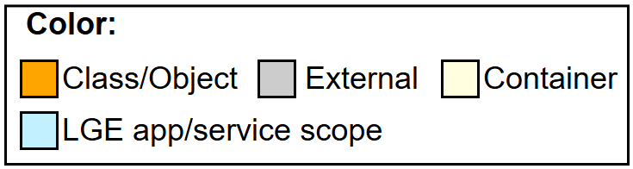
Detail design Alt-C: Forward API call from proxy to remotediag
Notes:
For detail design, I presents here the sequence diagrams when modules in EP sides want to send messages to RemoteDiag.
The Proxy receives then forwards the messages via UnixSocketClient class, then RemoteDiag hanldes the messages after it received from UnixSocketServer class..

Slide 13
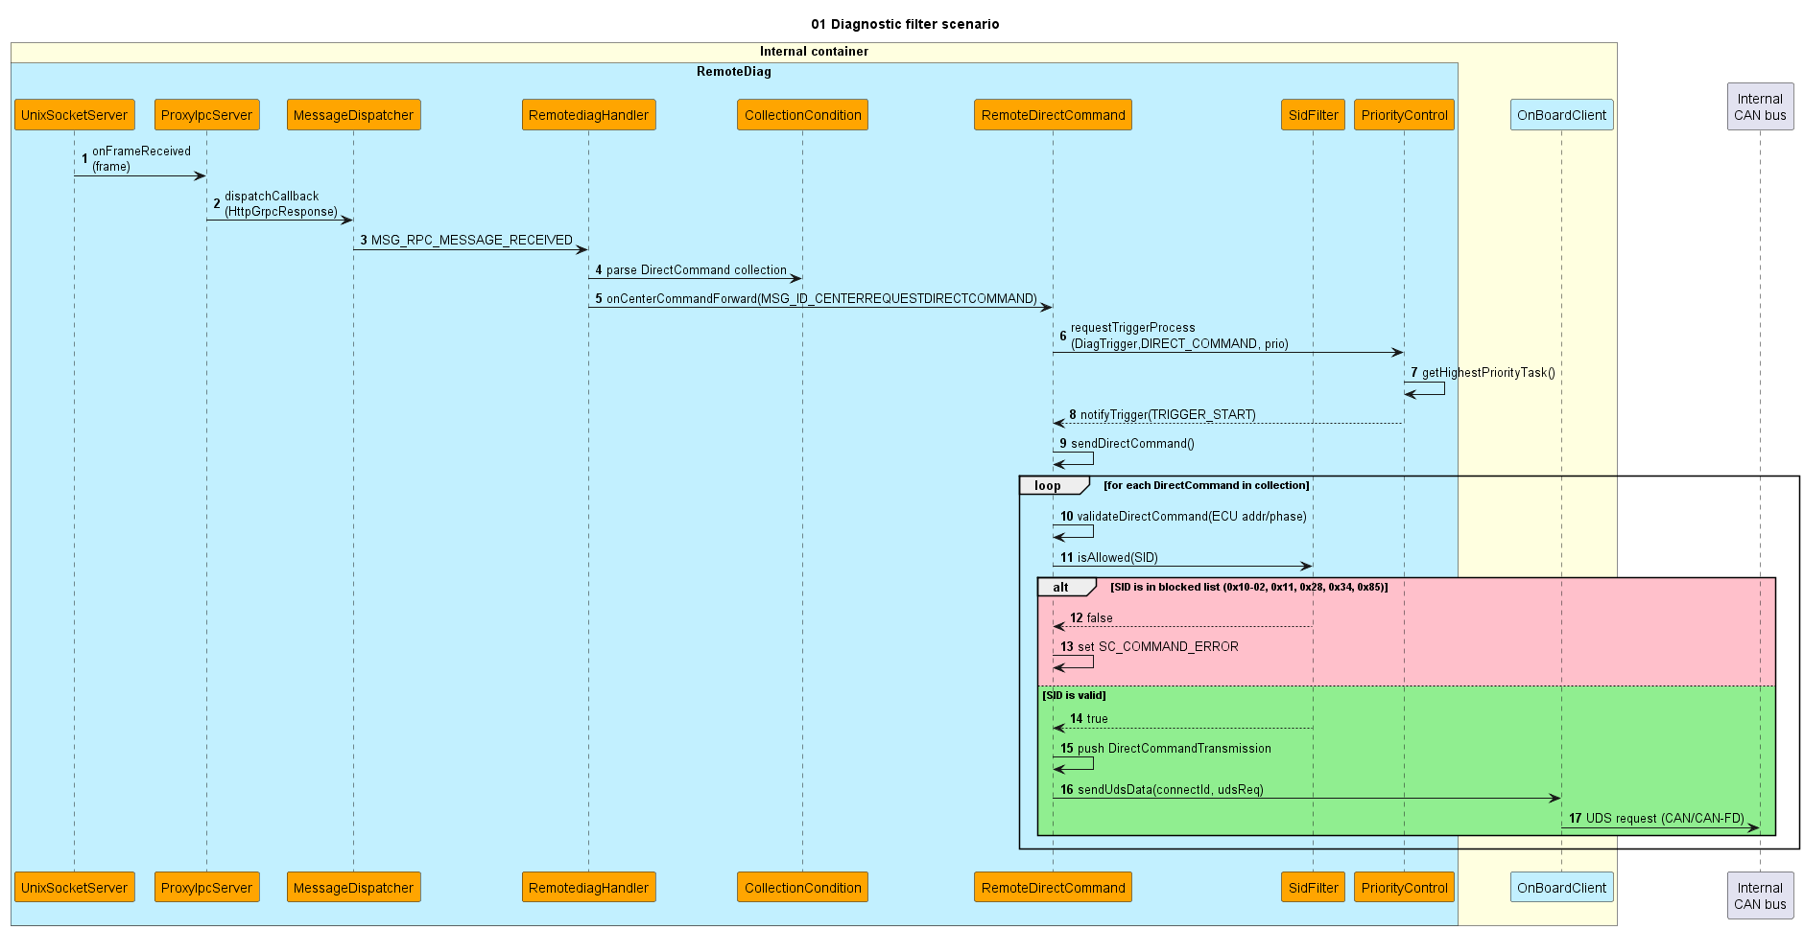
Detail design Alt-C: Filter scenario
Notes:
This is the filter scenarios when RemoteDiag received a direct diagnostic command.
It will validate the Service ID from diagnostic command before allowing it to be sent to Internal CAN bus.

Slide 14
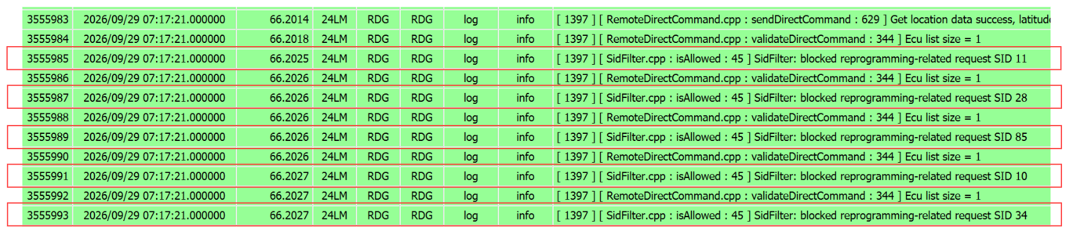
Implementation and Verification
SidFilter blocks reprogramming diagnostic requests

Slide 15
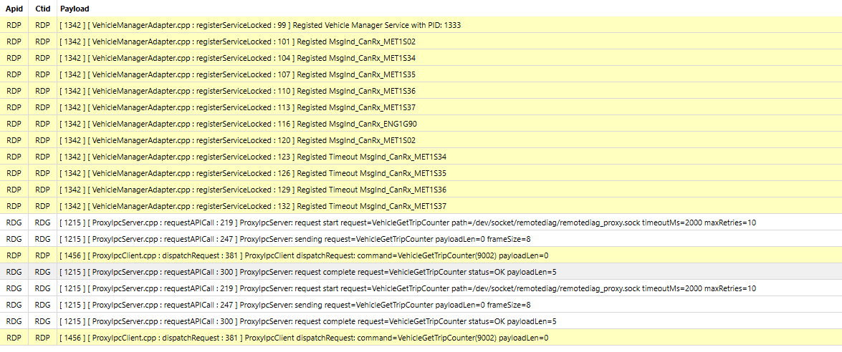
Implementation and Verification
RemoteDiagProxy and RemoteDiag communication

Slide 16
Q&A
Thank you for listening
Notes:
That’s all. If you have any question please tellme
I would like to say Thank you to the judges for listening for my FE presentation
and I appreciate the support from my mentors Mr. Bu yong kim.

Slide 17
Appendix

Slide 18
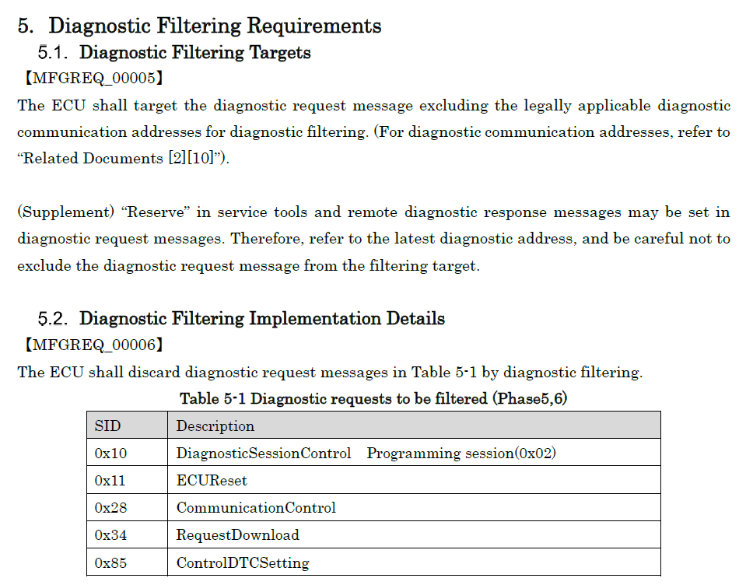
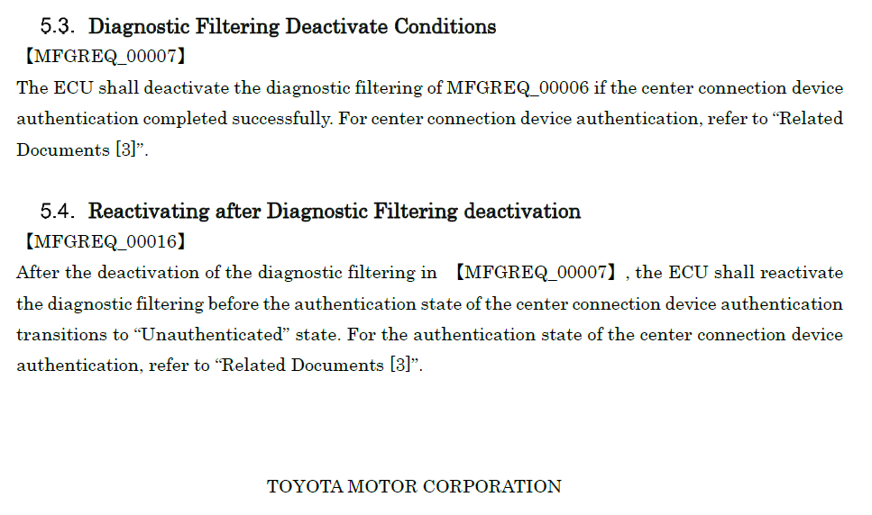
Diagnostic filtering requirements

Slide 19
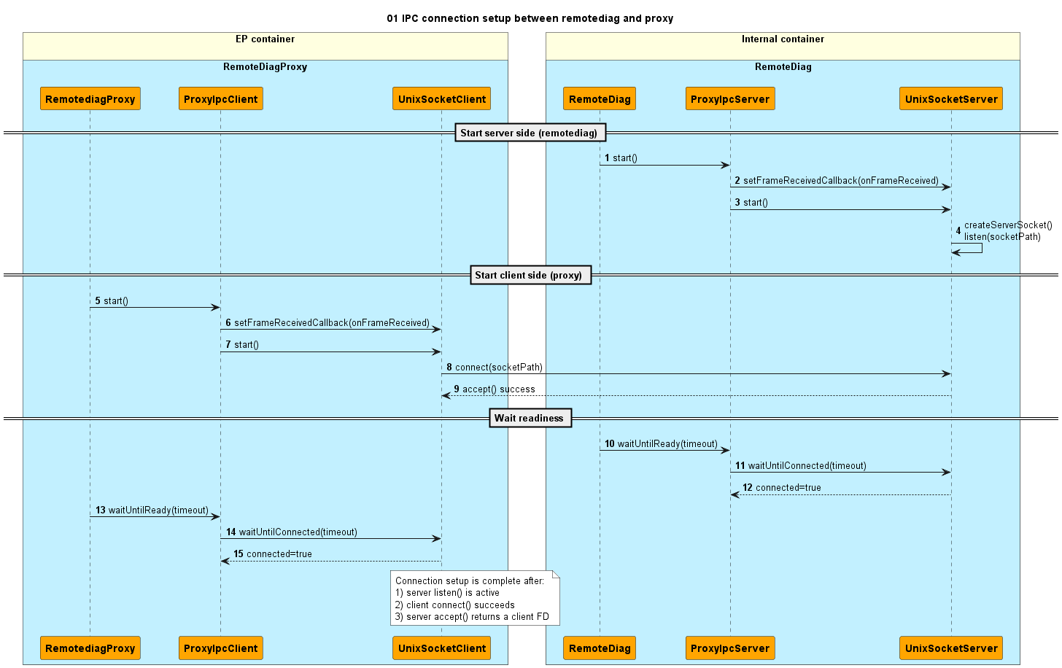
Detai design: IPC connection setup

Slide 20
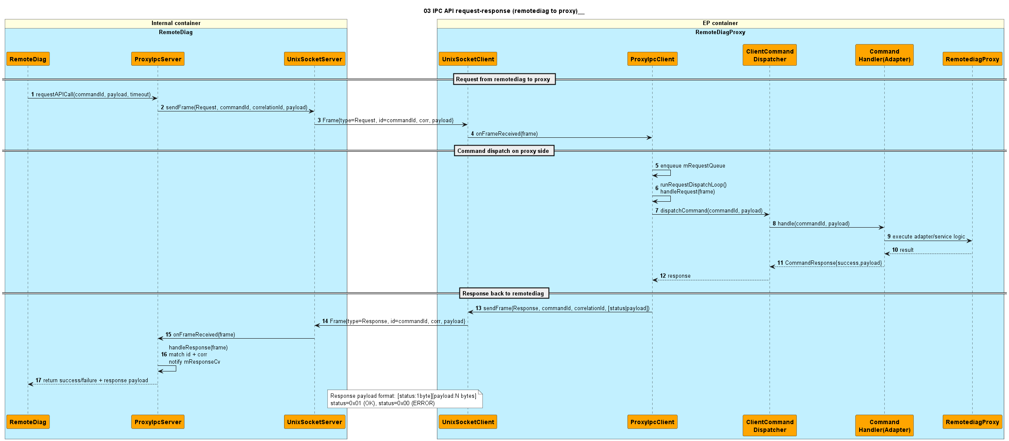
Detail design: API request-response

Slide 21
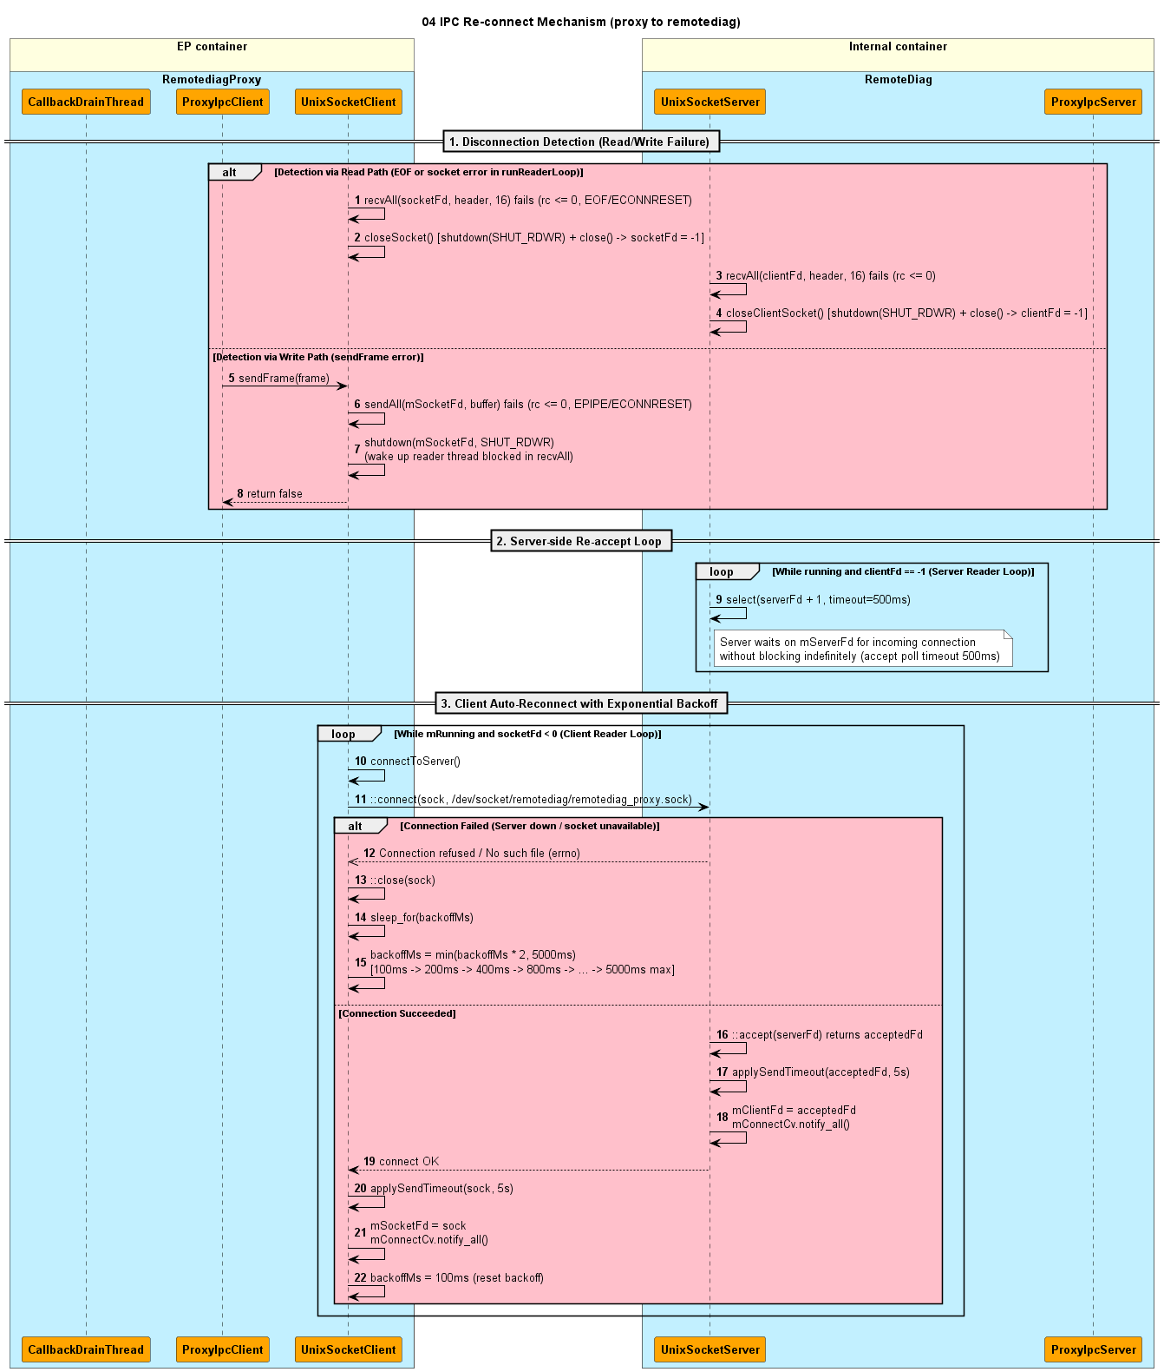
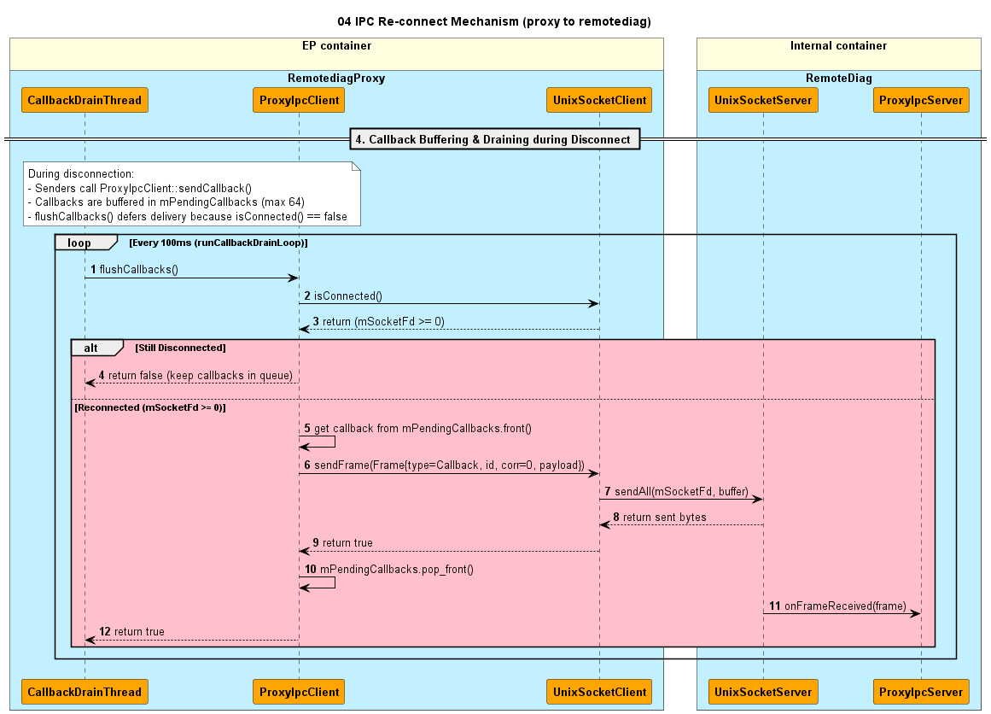
Detail design: Re-connect mechanism

